Slide 1

Socio-Technical Innovation Bundles for Agri-Food Systems Transformation
Christopher B. Barrett
Cornell University
Discussion w/Environmental Defense Fund’s Climate Smart Ag Team
May 9, 2022

Slide 2







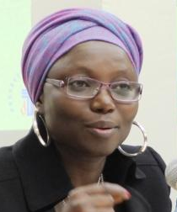
















Expert panel
Cornell Atkinson – Nature Sustainability 2020 expert panel on “Innovations to Build Sustainable, Equitable, Inclusive Food Value Chains,” a diverse group of 23 experts from across disciplines, regions, organizations, etc., w/10 additional co-authors.
Based on the”, released Dec. 2020.

Slide 3
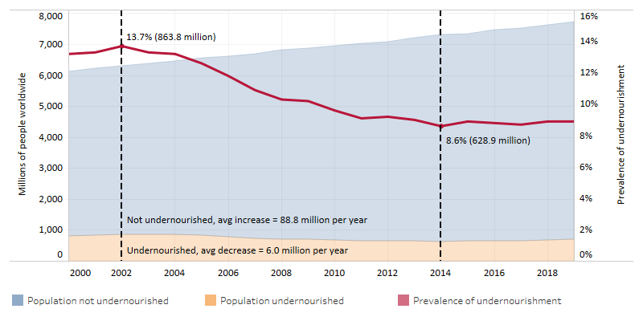
Core motivation
We must hold two fundamental truths firmly in mind:
(1) 1960s/70s objectives – grow supply of staple cereals to avert famine – sparked AFS innovations that enabled huge advances in human well-being.
(2) Those innovations also had major, adverse, unsustainable spillover effects on climate, natural environment, public health/nutrition, social justice.

Slide 4
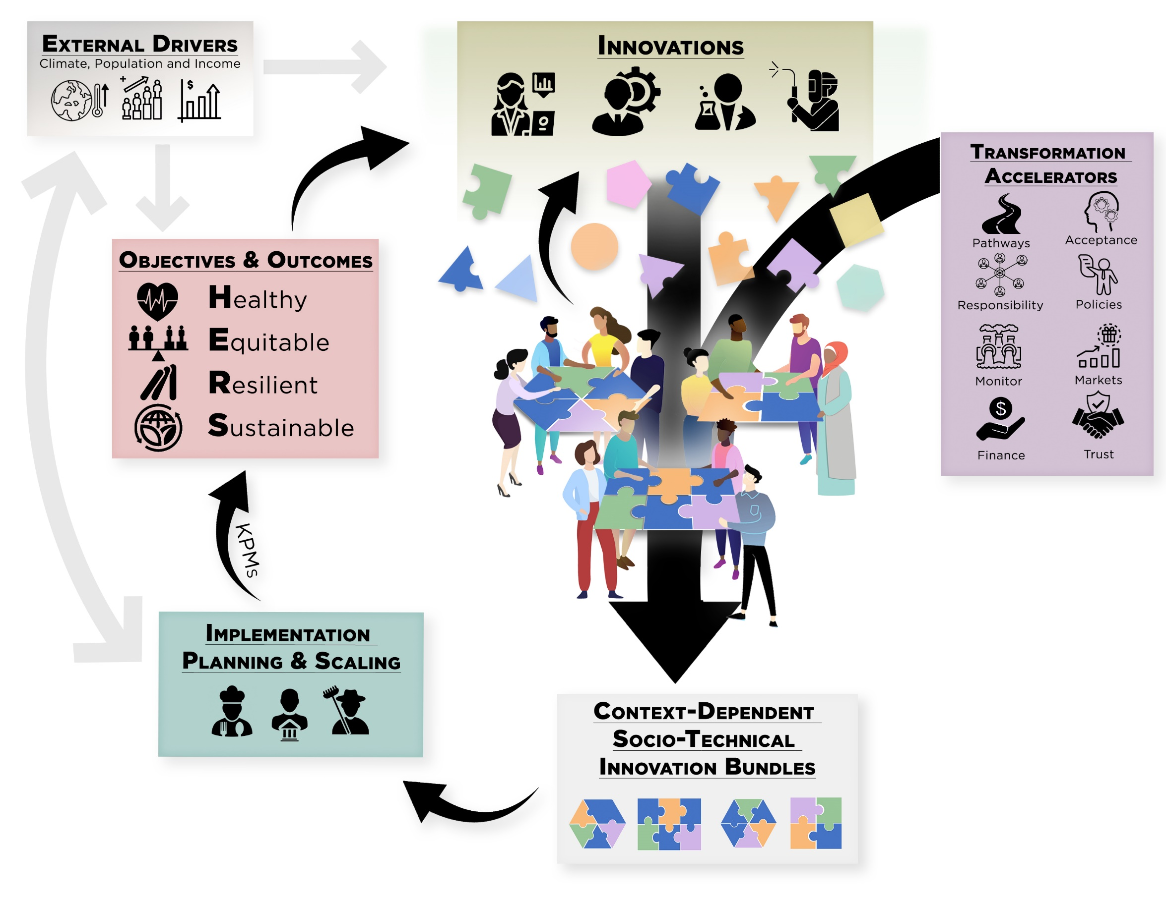
Key conclusions
We must update objectives, accelerate/reorient innovations for 21st century: productivity growth for agri-food systems (AFS) that are healthy, equitable, resilient and sustainable (HERS).

Slide 5
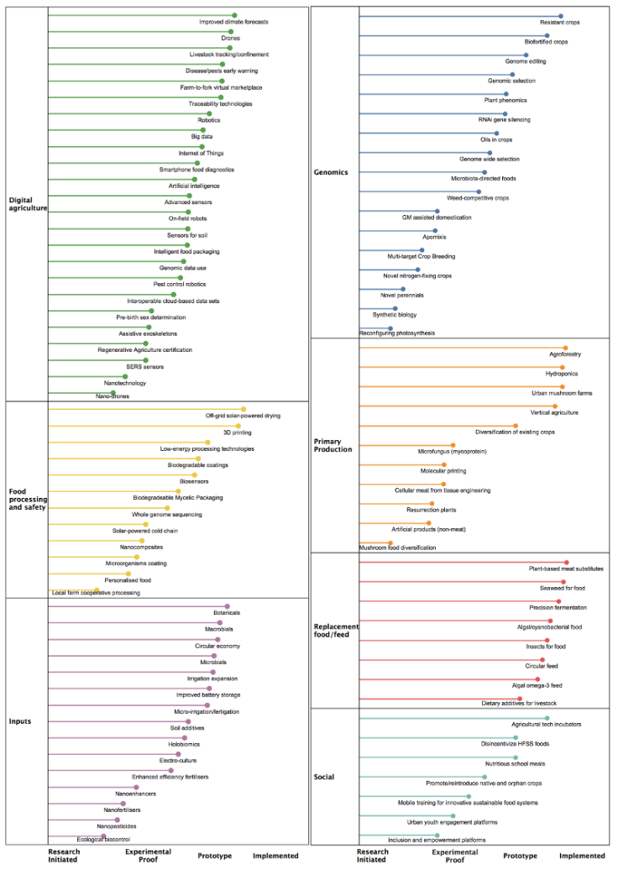
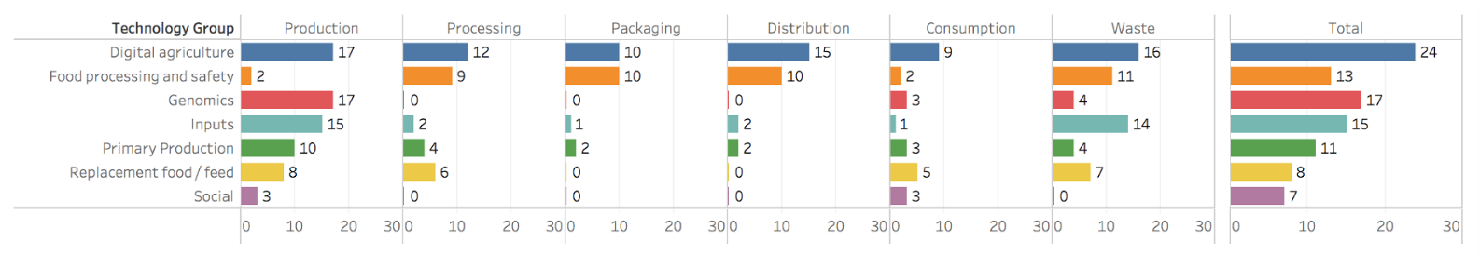
Key conclusions
A profuse pipeline exists of promising (natural and social) science advances at various stages of deployment readiness. These span value chains and geographies.

Slide 6
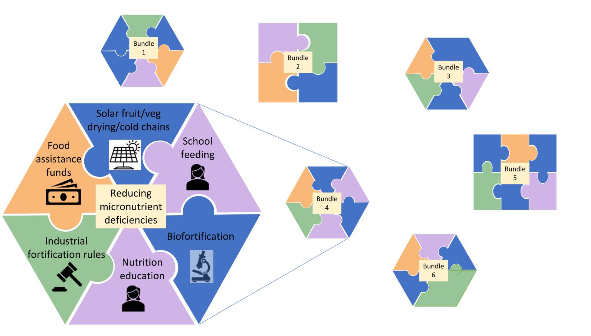
7 Essential Actions
Develop socio-technical innovation bundles
Why bundle?
  No magic bullets exist. Multiple constraints; relaxing just one limits progress. Must realize synergies to adapt/scale.
  Must address political economy of spillovers and creative destruction. Coalitions from bundling can overcome incumbent status quo bias
  Heterogeneous needs require bundled solutions

Slide 7

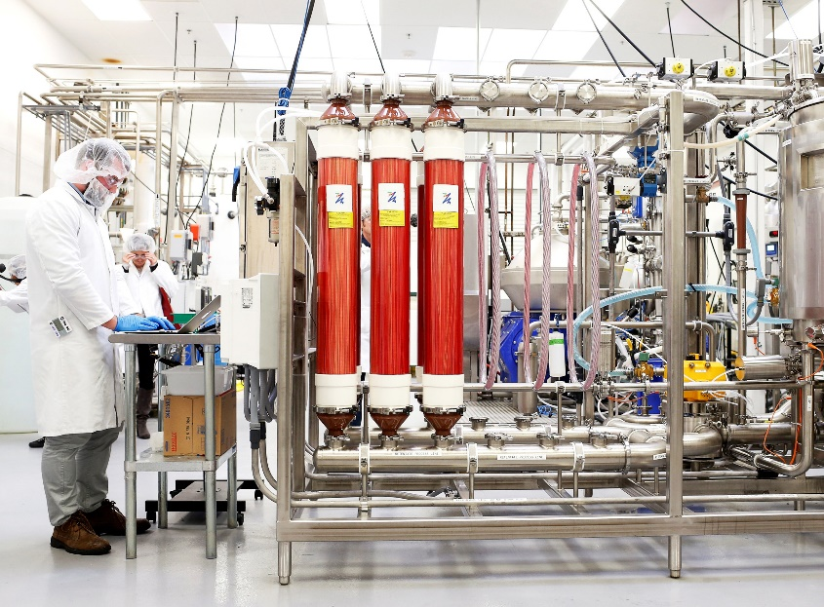
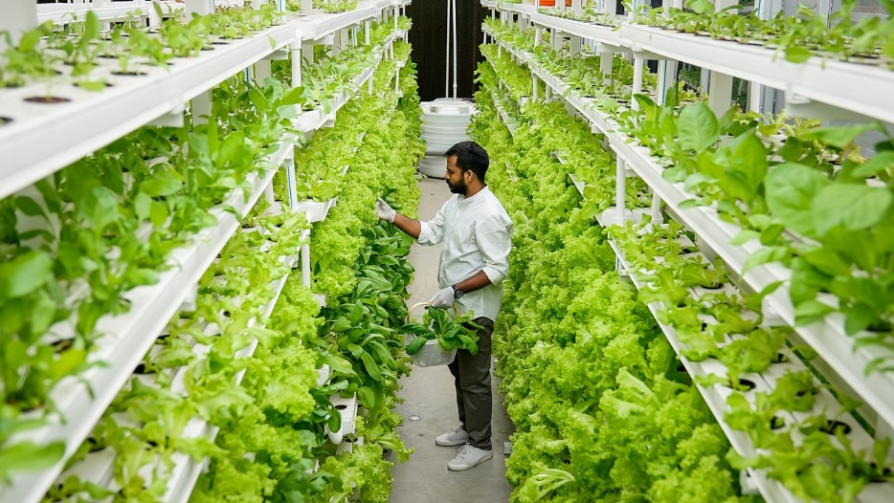
7 Essential Actions
2. Reduce the land and water footprint of food
Decoupling food production from land increasingly culturally, economically, technologically feasible. Must manage de-agrarianization’s creative destruction.
Photo: Beck Deifenbach/Reuters
Photo: Gerry Machen/Creative Commons
Photo: Betterindia.com

Slide 8
7 Essential Actions
3. Reconfigure public support for AFSs
Two key roles for gov’ts:
1. invest in essential public goods and services: e.g., R&D
2. facilitate dialogue to find cooperative solutions
Much current government AFS spending is wasteful (>$2bn/day!). Redirect towards social protection programs, AFS research, and physical/institutional infrastructure. Starts w/current US Farm Bill cycle and WH Hunger conference.
Foster civil society dialogues to identify and support contextually appropriate socio-technical bundles.

Slide 9
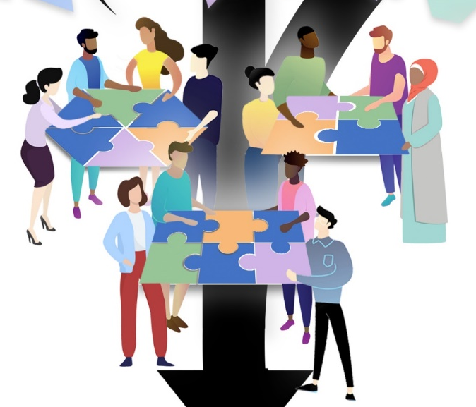

Other Essential Actions
4. Commit to co-creation with shared and verifiable responsibility Agreed KPMs, safety nets, penalties can accelerate beneficial innovation and minimize adverse unintended consequences.
5. Deconcentrate power
Reducing market and political power imbalances and broadening participation in innovation dialogues can accelerate innovation.
6. Mainstream systemic risk management
COVID-19 underscores the rising importance of effective systemic risk management. Need innovative risk reduction and risk transfer mechanisms.
7. Develop novel financing mechanisms
AFS innovations require $$$ (hundreds of billions annually).
How to mobilize private resources beyond philanthropy? Landscape bonds and other impact investment, benevolent patent extensions, etc.

Slide 10
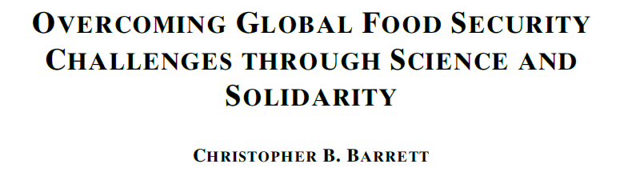

Thank you
Report and associated journal articles, videos, etc. available at https://blogs.cornell.edu/nature-sustainability/
Thank you for your time and interest!

